Slide 1


SMART INDIA HACKATHON 2025
Problem Statement ID – SIH 25061
Problem Statement Title - Digitize and
Showcase Monasteries of Sikkim for
Tourism and Cultural Preservation
Theme - Travel & Tourism
PS Category- Software
Team ID-50617
Team Name - Promatrs

Slide 2


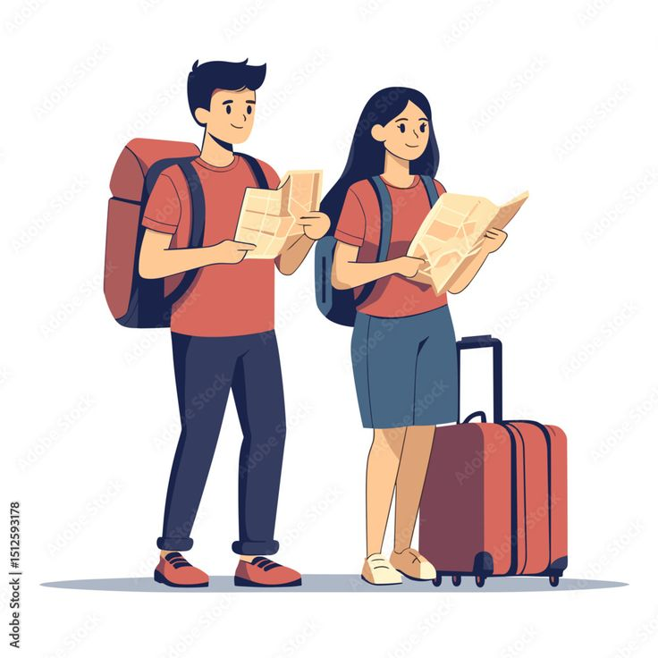
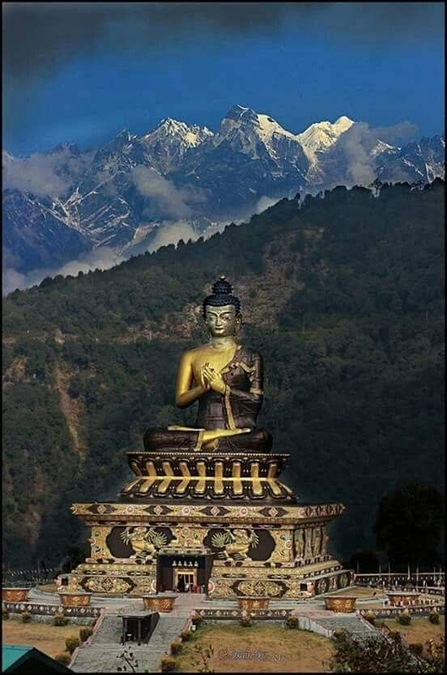
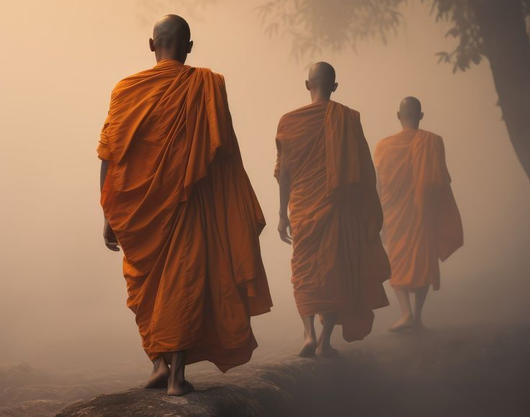
Promatrs
Digitize and Showcase Monasteries of Sikkim for Tourism and Cultural Preservation
PROBLEM STATEMENT
Despite over 200 monasteries in Sikkim, digital access remains fragmented, limiting global engagement and preservation efforts.
Many monasteries lack digital platforms to showcase their rich cultural heritage, resulting in missed opportunities for education and tourism.
Traditional ticketing systems are outdated, leading to overcrowding and reduced visitor satisfaction.
PROPOSED SOLUTION
Offline-First Access: Ensures usability in remote areas with limited internet connectivity.
360° Virtual Tours: Provides immersive experiences of monastery interiors and surroundings.
Multilingual Audio/Video Guides: Caters to a diverse audience with language preferences.
AI-Powered Search: Enables quick access to specific information and locations
Interactive Maps: Guides visitors through monastery locations, routes, and nearby attractions.
Digital Ticketing & Booking: Facilitates smooth visitor management and reduces overcrowding.
Use photogrammetry tools to create textured meshes → export FBX/OBJ for Unity(Used in our implemented Project and It is available for download in VR Quest(Link is mentioned below).
VR interactions (hotspots, text overlays, teleport/motion mode
Who We Serve
Domestic and International Tourists
Monastery Authorities
Sikkim Government / Business Authorities
Our MVP : https://www.youtube.com/shorts/VSu_6MMC6hk
VR murugan Available in following link: https://sidequestvr.com/app/44174/campus-tour

Slide 3
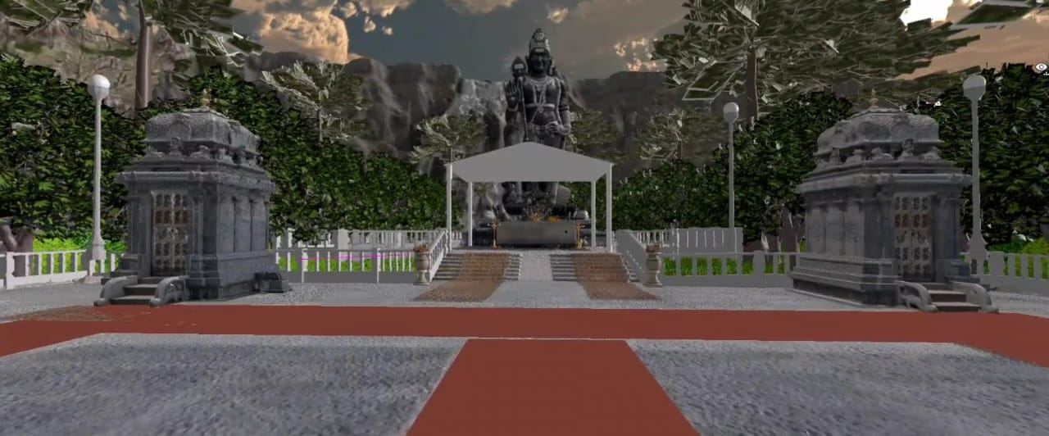
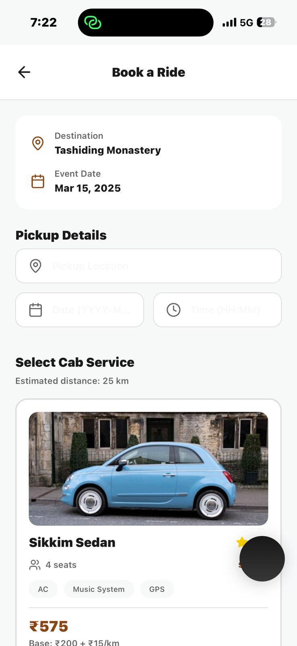
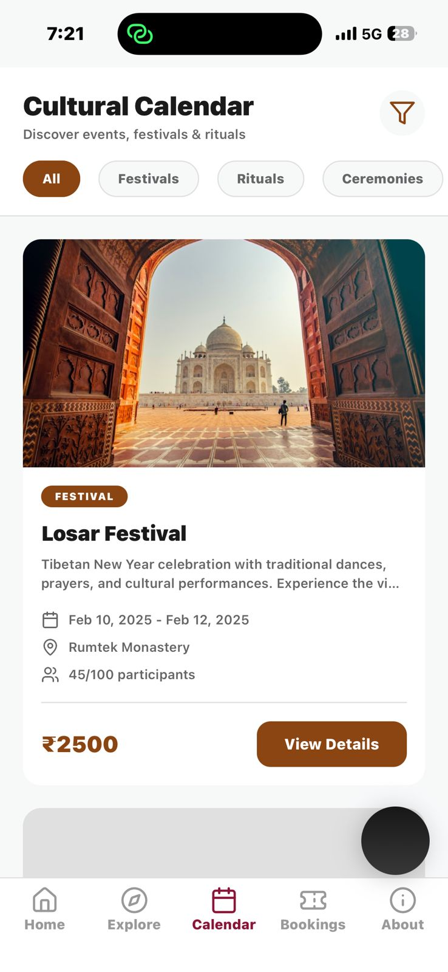
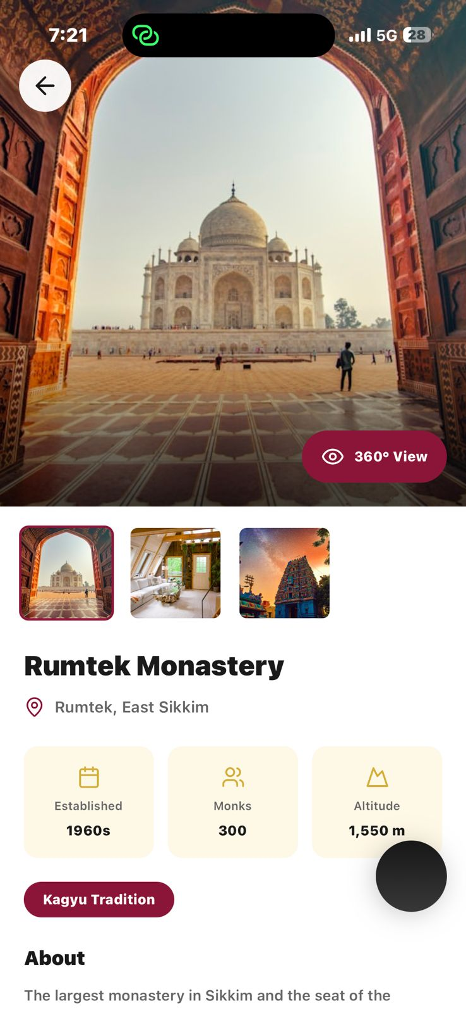
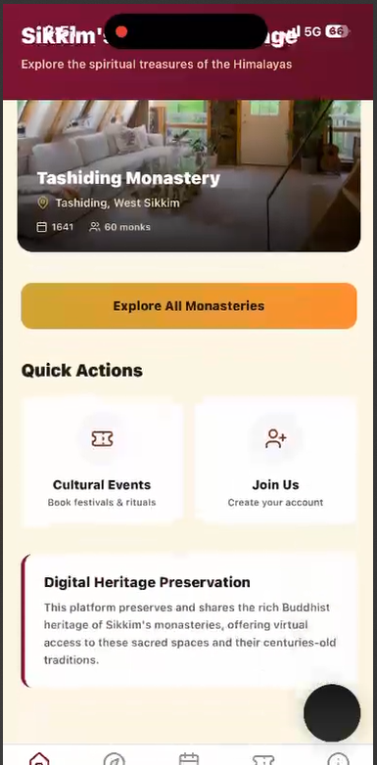
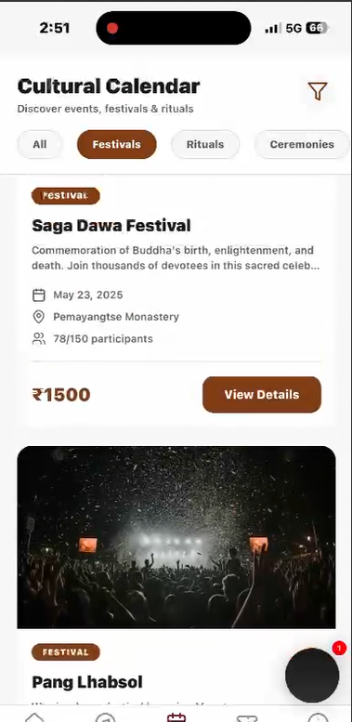
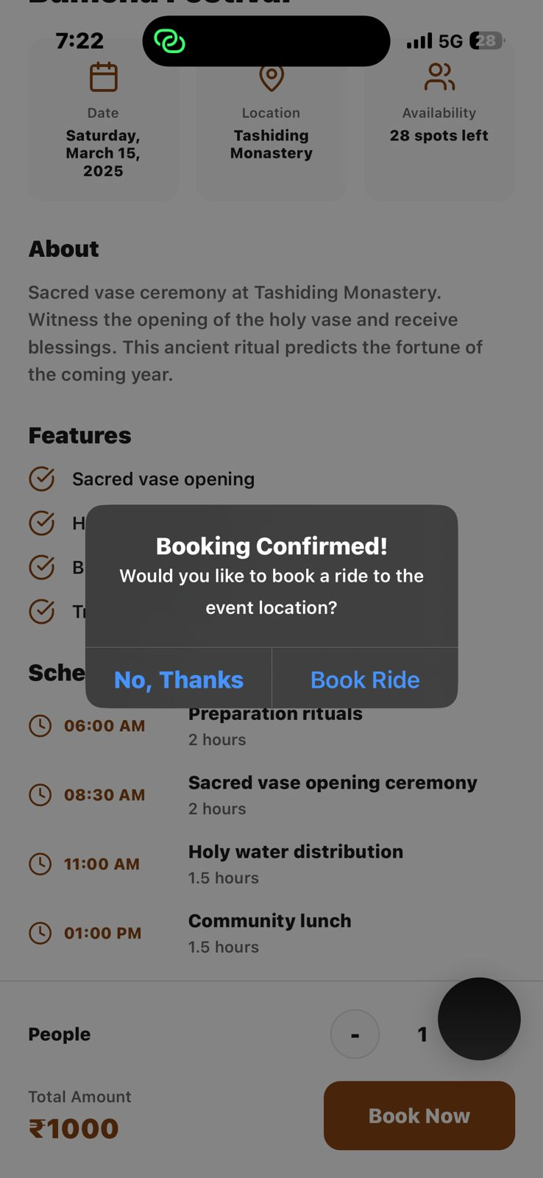
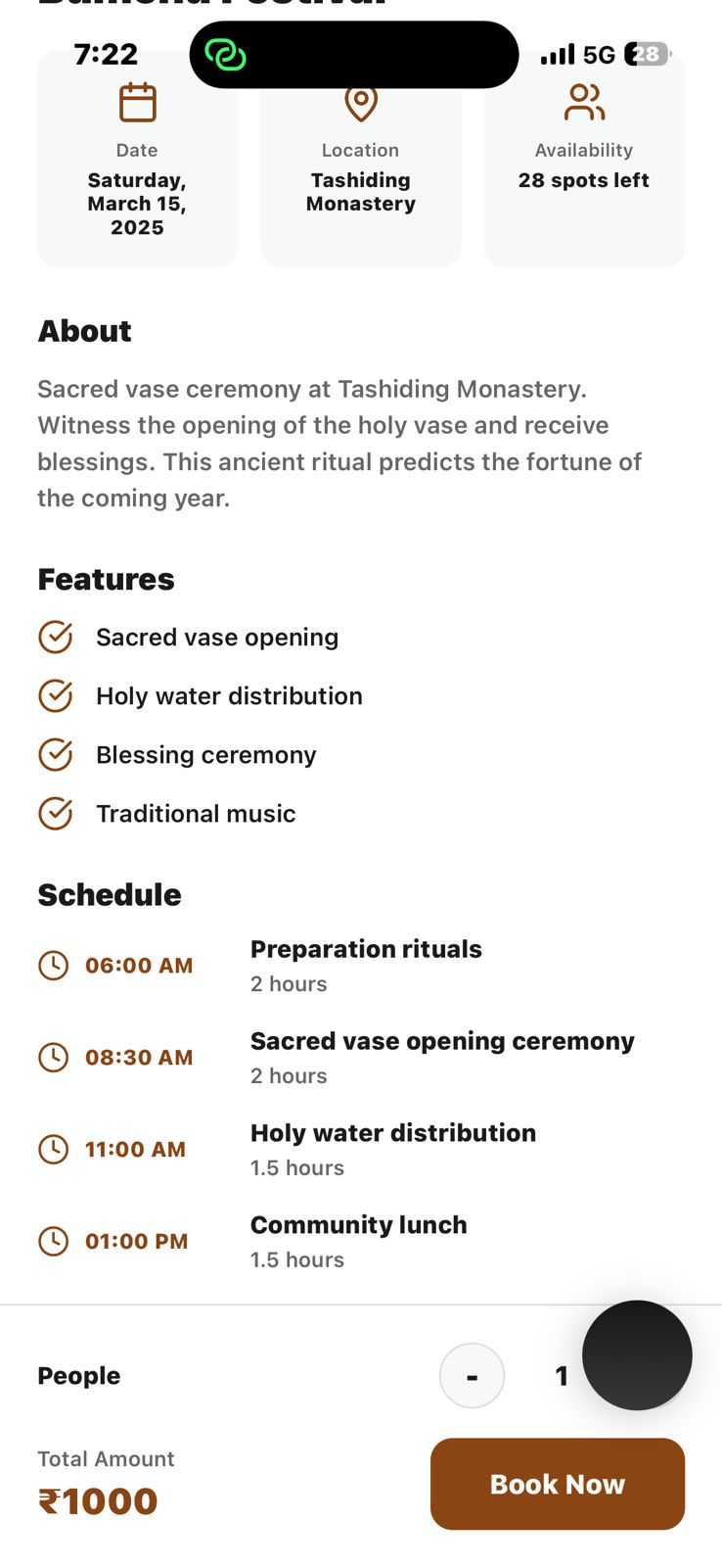
TECHNICAL APPROACH
Promatrs
Our implemented VR Murugan virtual Tour
Technologies Used
Capture: 360 camera + photogrammetry image set (for 3D models).
Processing: Use photogrammetry tools to create textured meshes → export FBX/OBJ for Unity.
Optimization: LODs, light baking, normal maps for mobile/VR.
Interaction: reuse your Murugan VR interactions (hotspots, text overlays, teleport/motion mode).
React Native—Cross-platform mobile app
Location Services—Bluetooth and Mapbox
AR/VR Platforms - Unity
Offline Mode - SQLite
Tourism Integration—APIs for local transport
Figma - UI/UX Design
For detailed understanding, click here.

Slide 4
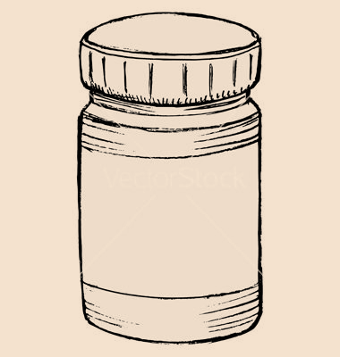
FEASIBILITY AND VIABILITY
Promatrs
Operational Feasibility
Technical Feasibility
Financial Feasibility
Rural & remote-ready, continuous cultural engagement
User-friendly app for tourists, researchers, monks, and local communities.
Scalable mobile and cloud platform with 360° tours and drone & 3D scanning integration
APIs for tourism, GPS/Bluetooth-based with offline mode.
Low-cost, app-based digital heritage platform.
Scalable via public–private partnerships, CSR funding, and grants from cultural and educational organizations.
Feasibility
User Adoption: Tourists, researchers, and locals may struggle with low digital literacy or hesitate to use new technology.
Connectivity Issues: Remote monasteries with poor internet may restrict access to virtual tours and digital archives.
Cultural Sensitivity: Bureaucratic or religious constraints can limit filming, digitization, and community participation.
Multi language Support(We are working in this)
Challenges and Risks
Risks and Mitigation
Providing an intuitive UI, offline tutorials, and on-site guidance to help tourists, researchers, and locals comfortably use the app.
Using an offline-first design with cached content and periodic syncing to ensure uninterrupted access in remote monasteries.
Engaging monastery authorities early and follow culturally respectful practices to obtain approvals and ensure smooth digitization.

Slide 5
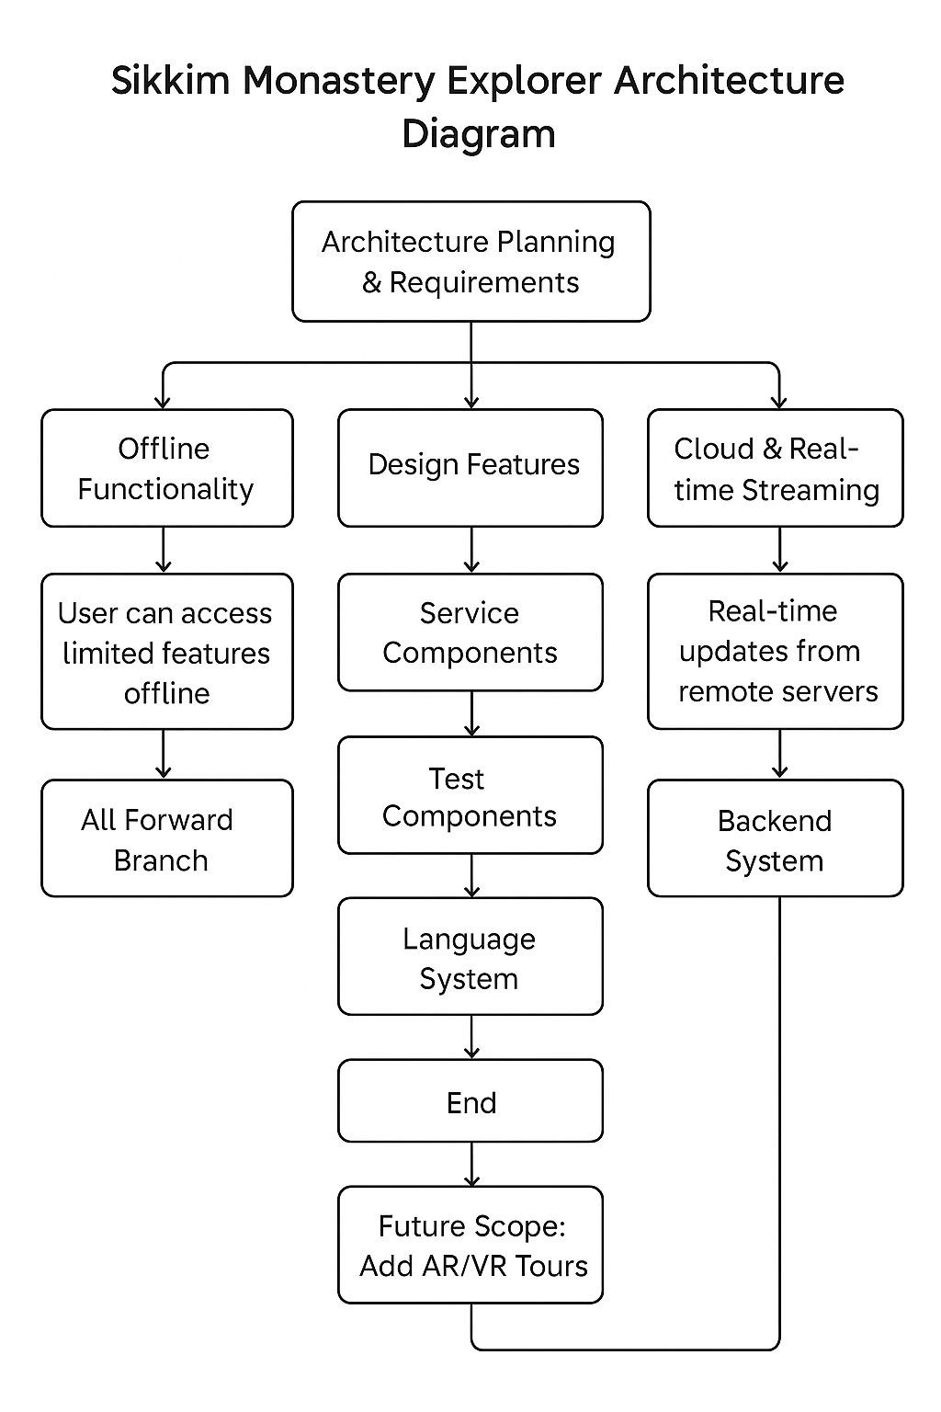
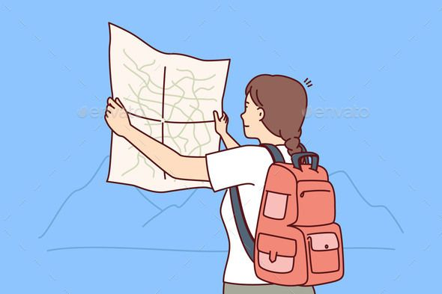
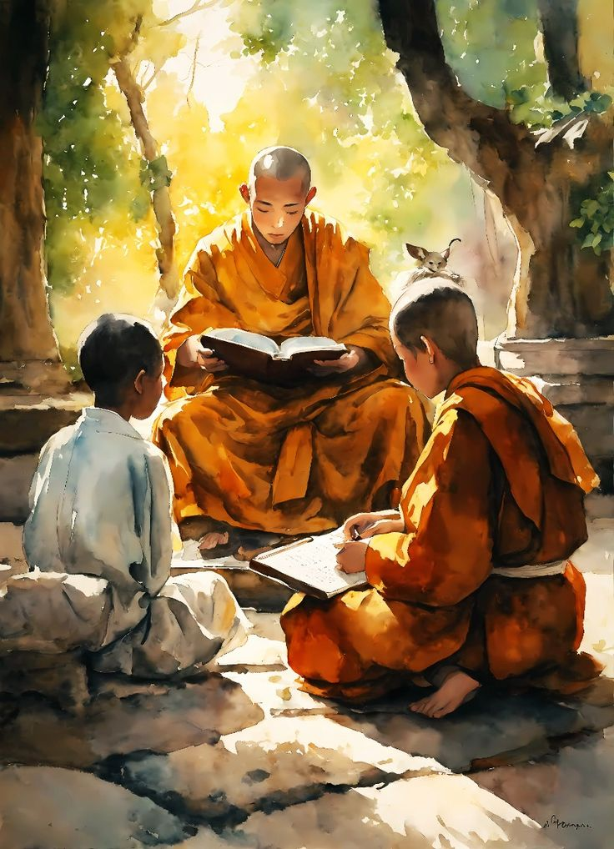
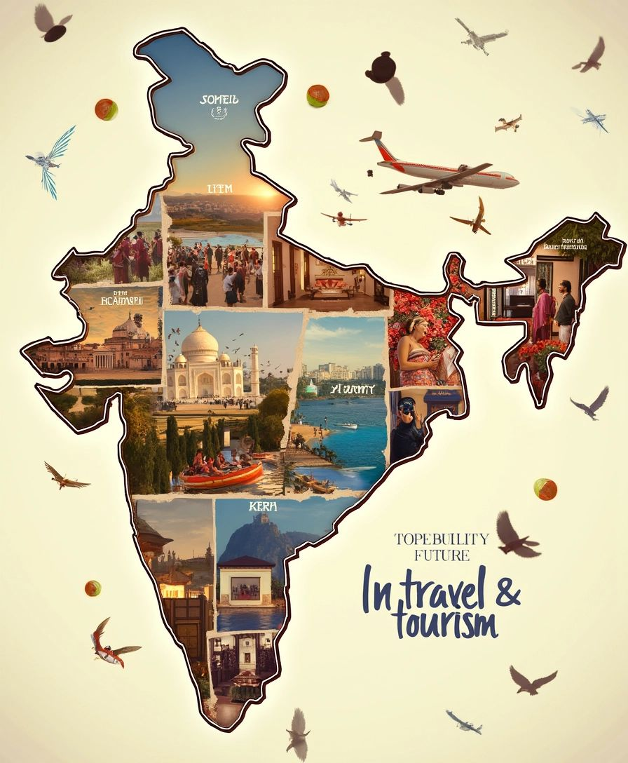
IMPACT AND BENEFITS
Promatrs
For Tourists and Travelers
- Gain easier and personalized monastery exploration.
- Easy navigation, offline guides, multilingual support, immersive experiences.
For Monks And Monasteries
- Personalized monastery journeys
with 360° tours.
- Easy navigation with offline guides, multilingual support, and maps.
For GOVERNMENT/TOURISM
BOARD
- Boost tourism by monitoring visitors.
- Global promotion with sustainability.

Slide 6
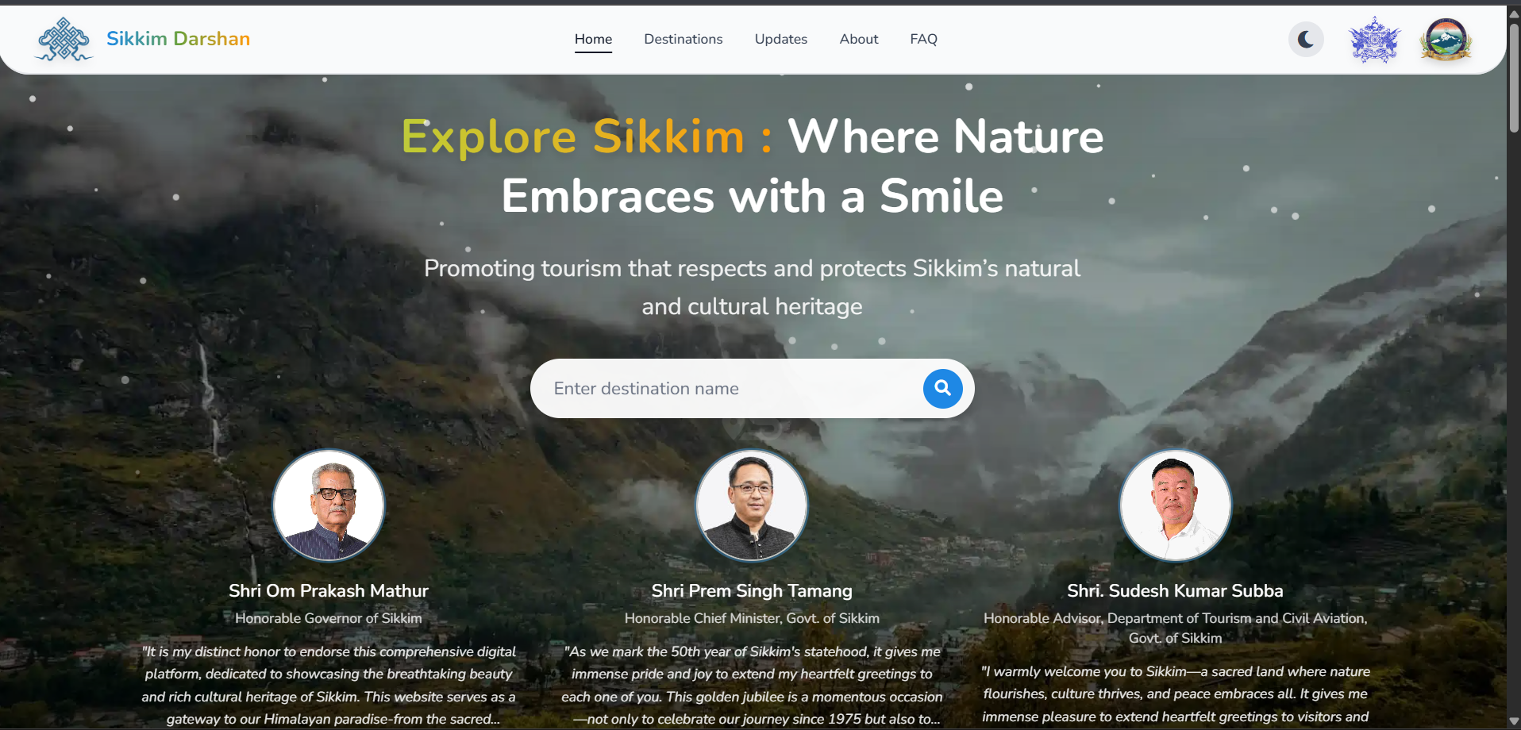
RESEARCH AND REFERENCES
Promatrs
Government Initiatives
Relevant Platforms
Sikkim Darshan: A QR-based and audio guide-enabled digital platform launched in May 2025, offering detailed information, multimedia, and real-time updates for over 50 attractions in Hindi, English, and Nepali.
Fyule Video Lab: Provides virtual walkthrough videos of historical monuments like Rumtek Monastery, integrating art and history for educational purposes.
Cultural Affairs and Heritage Department, Sikkim
The department focuses on preserving the unique cultural heritage of the state by identifying and conserving heritage monuments. Sikkim Government
Preservation of Religious Manuscripts and Artifacts
The government implements policies for the preservation of heritage sites and religious relics, collaborating with UNESCO and other international bodies.
Sikkim Palace Archive Digitisation Project
This project aims to preserve, digitize, and make available to academic inquiry the previously neglected royal archives of the former Himalayan Buddhist kingdom of Sikkim.

Slide 7
IMPORTANT INSTRUCTIONS
Please ensure below pointers are met while submitting the Idea PPT:
Kindly keep the maximum slides limit up to six (6). ( Including the title slide)
Try to avoid paragraphs and post your idea in points /diagrams / Infographics /pictures
Keep your explanation precise and easy to understand
Idea should be unique and novel.
You can only use provided template for making the PPT without changing the idea details pointers (mentioned in previous slides).
You need to save the file in PDF and upload the same on portal. No PPT, Word Doc or any other format will be supported.
Note - You can delete this slide (Important Pointers) when you upload the details of your idea on SIH portal.

